Slide 1
Artificial Intelligence and Machine Learning Project
Team Details:
Mishty (2210990579)
Muskan (2210990590)
Navneet (2210990600)
Malika (2210990549)
Faculty Coordinator: Ms Monica Dutta
:
Chitkara University Institute of Engineering and Technology,
Chitkara University, Punjab

Slide 2
Table of Contents
Abstract
Introduction
Problem Statement
Brief about Loan Prediction System
Objectives
Dataset Overview
Flow Chart
Tools and technologies
Result
Future scope
Conclusion
Reference

Slide 3
Abstract
In an era where access to financial resources is crucial for individual and societal progress, equitable lending practices are imperative. However, traditional loan evaluation systems often exhibit biases, leading to discriminatory outcomes. To address this challenge, we present our AI Loan Prediction System, a cutting-edge application of machine learning algorithms designed to revolutionize lending decisions.
Our system leverages advanced machine learning techniques to analyze loan applications impartially, considering factors such as gender, marital status, income, and credit history. By harnessing the power of data analytics and artificial intelligence, we ensure fairness, transparency, and accuracy in lending decisions, thereby promoting financial inclusivity and social equity.
Through this project, we aim to contribute to a more just and accessible financial landscape, where individuals are evaluated based on their merits rather than demographic characteristics. Join us on this journey towards equitable lending practices and inclusive economic empowerment.

Slide 4
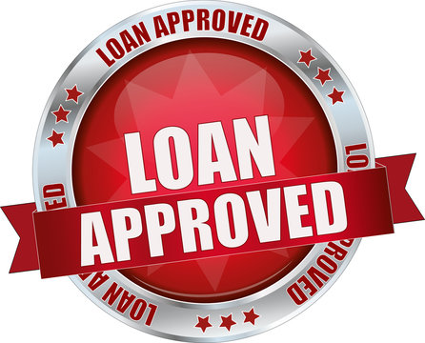
Introduction
The aim of a loan approval prediction project in machine learning is to develop a model that can predict whether a loan application should be approved or denied based on various factors.
This project typically involves:
Data Collection: Gathering relevant applicant information, financial history, and loan details.
Data Preprocessing: Cleaning and transforming collected data for analysis.
Feature Selection/Engineering: Identifying relevant features or creating new ones to enhance model performance.
Model Selection and Training: Choosing suitable machine learning algorithms and training them on prepared data.
Model Evaluation: Assessing model performance using
metrics like accuracy, precision, recall, and F1-score.
Deployment: Implementing the trained model into a
real-world application for practical use in loan
approval decisions.

Slide 5
Problem Statement
Inequitable lending practices persist in the financial industry, leading to discriminatory outcomes.
Traditional systems exhibit biases based on factors like gender, race, and socioeconomic status.
Key Challenges:
* Bias in Decision Making
* Lack of Transparency
* Inefficient Processes
* Limited Access to Credit
Addressing these challenges requires a shift towards data-driven and equitable lending practices.
Our AI Loan Prediction System aims to mitigate biases, enhance transparency, and improve efficiency in loan approval decisions using machine learning and data analytics.

Slide 6
Loan Prediction System
The Loan Prediction System project aims to develop an automated system using machine learning algorithms to predict whether a loan application should be approved or denied. This system utilizes a dataset containing various attributes such as gender, marital status, income, credit history, and property location to make predictions.
The primary objective of the project is to streamline the loan approval process, ensuring fairness, efficiency, and transparency. By analyzing historical loan data and employing advanced algorithms, the system can accurately assess the creditworthiness of applicants and make informed lending decisions.
Key components of the project include data collection, preprocessing, feature selection/engineering, model training, evaluation, and deployment. Throughout the project, considerations for regulatory compliance, ethical AI practices, and customer-centric solutions are prioritized.
Ultimately, the Loan Prediction System aims to contribute to a more inclusive financial landscape by providing access to credit for deserving individuals while minimizing the risk of defaults for lending institutions.

Slide 7
.

Slide 8

Objectives
Develop a machine learning model to predict loan approval outcomes accurately.
Mitigate biases in lending decisions by ensuring fairness and transparency.
Enhance efficiency in the loan approval process through automation and data-driven insights.
Foster trust and accountability in lending institutions by implementing transparent decision-making processes.
Streamline the loan application
process for both applicants and
financial institutions.

Slide 9
Dataset Overview
Description of the dataset, including the various attributes and their meanings :-
# Loan_ID : Unique Loan ID
# Gender : Male/ Female
# Married : Applicant married (Y/N)
# Dependents : Number of dependents
# Education : Applicant Education (Graduate/ Under Graduate)
# Self_Employed : Self employed (Y/N)
# ApplicantIncome : Applicant income
# CoapplicantIncome : Coapplicant income
# LoanAmount : Loan amount in thousands of dollars
# Loan_Amount_Term : Term of loan in months
# Credit_History : Credit history meets guidelines yes or no
# Property_Area : Urban/ Semi Urban/ Rural
# Loan_Status : Loan approved (Y/N) this is the target variable

Slide 10
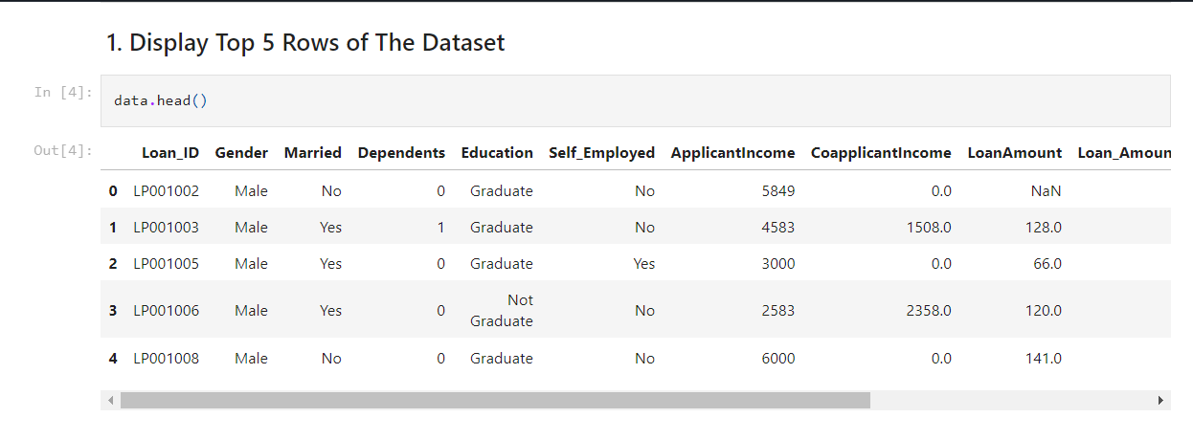
.
This is how our dataset looks like :

Slide 11
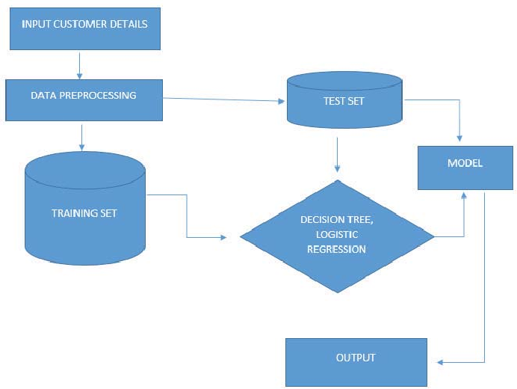
.
Flow Chart

Slide 12
Tools and technologies
Programming Languages:
Python: Used for data preprocessing, model development, and implementation.
Libraries and Frameworks:
Scikit-learn: Utilized for implementing machine learning algorithms and model evaluation.
Pandas: Employed for data manipulation and analysis.
NumPy: Used for numerical computations and array operations.
Data Visualization:
Matplotlib: Used for creating static plots and visualizations.
Seaborn: Employed for statistical data visualization.
Development Environment:
Jupyter Notebook: Used for interactive data exploration, analysis, and model development.

Slide 13
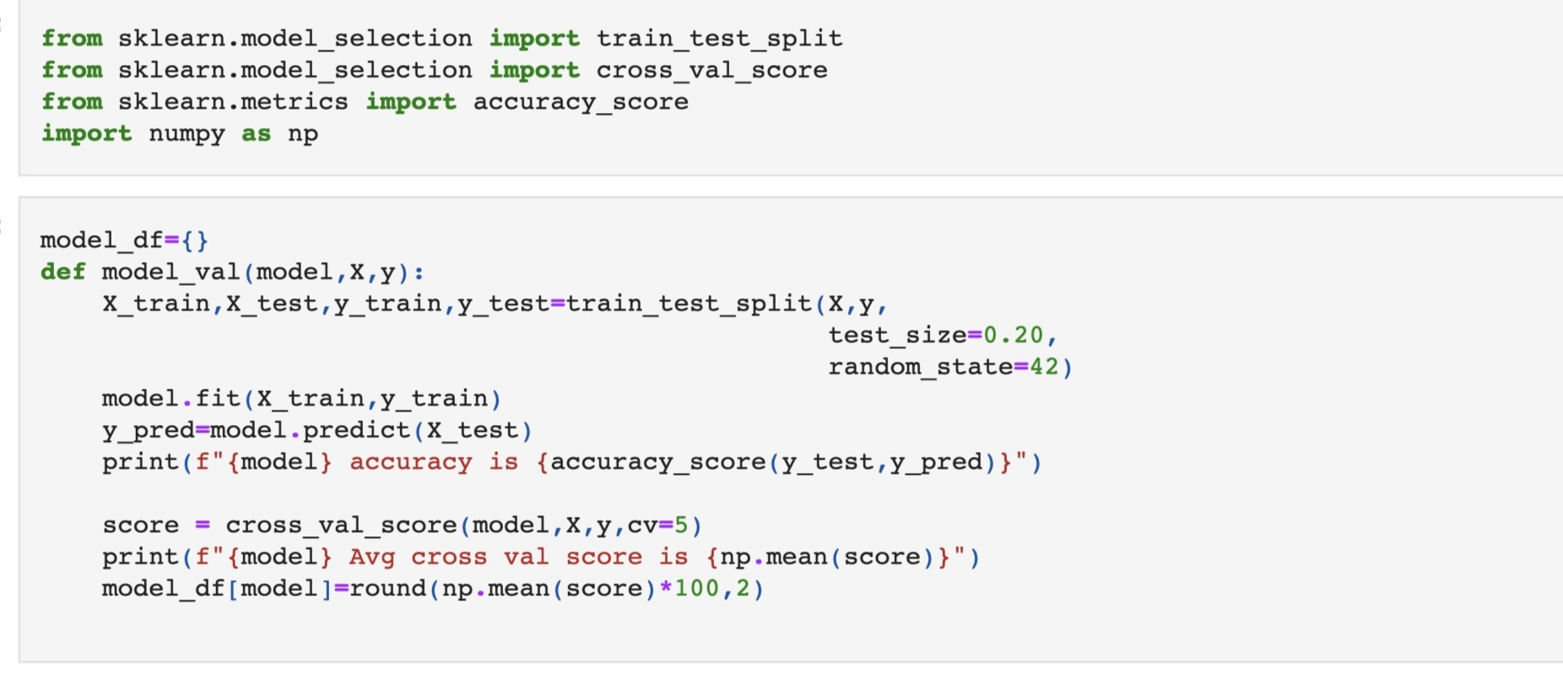
TRAINING & TESTING SPLIT
.

Slide 14
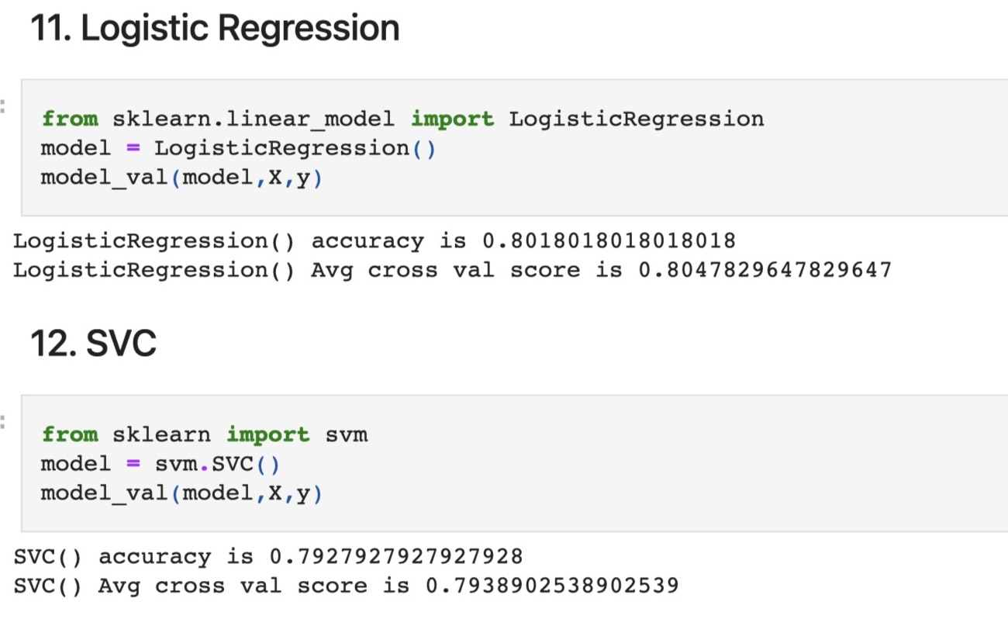
Results

Slide 15
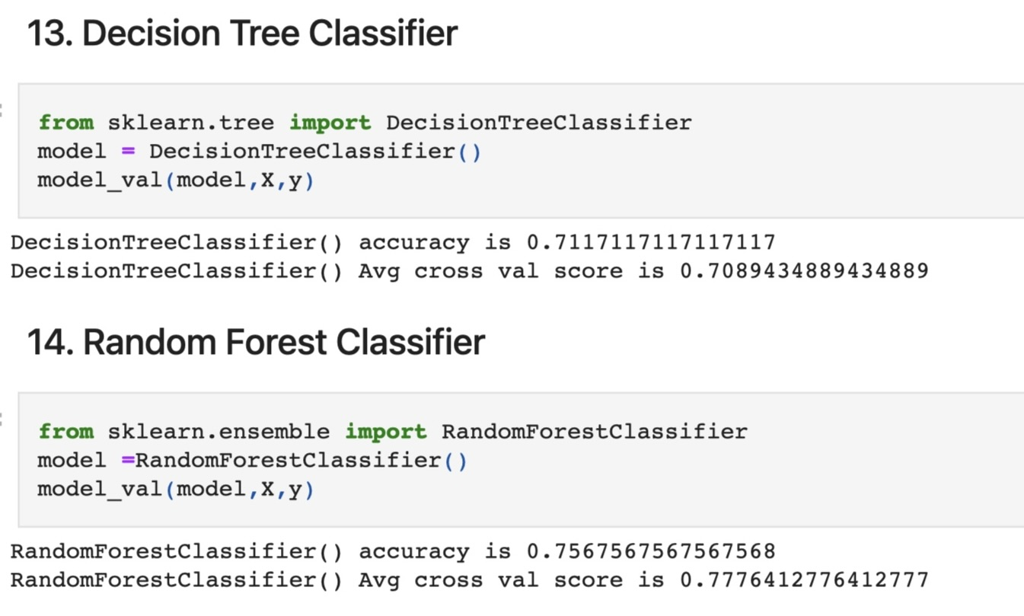
Results
.

Slide 16
Future Scope
Enhanced Financial Inclusion: Machine learning-powered loan prediction systems can expand access to credit by providing more accurate risk assessments, especially for underserved populations.
Lower Default Rates: Improved risk assessment leads to reduced defaults, lowering credit losses for lenders and improving portfolio performance.
Consideration of Various Factors: Incorporating multiple factors such as credit history, income, employment status, and debt-to-income ratio to make informed loan approval decisions, enhancing prediction accuracy and fairness.
Personalized Customer Experience: Tailored loan products and terms based on individual borrower profiles enhance customer satisfaction and retention.
Regulatory Compliance: Automated compliance checks and transparent decision-making ensure adherence to regulations and build trust with regulators and customers.
Continuous Improvement: Ongoing model refinement based on new data and feedback leads to better prediction accuracy and operational efficiency over time.

Slide 17
Conclusion
Our Loan Prediction System marks a significant milestone in the realm of financial technology, harnessing the power of machine learning to transform the loan approval process.
By integrating various data sources and employing sophisticated algorithms, we've developed a system that accurately predicts loan approval outcomes while mitigating biases and ensuring transparency.
Throughout this project, we've emphasized the importance of fairness, efficiency, and customer-centricity, aiming to provide a seamless borrowing experience for all.
As we conclude this project, we reflect on the strides made in advancing financial inclusivity, reducing defaults, and fostering trust in lending institutions.

Slide 18
Reference
https://github.com/DataThinkers/Machine-Learning-Projects-Code/blob/main/Loan%20Status%20Prediction%20Using%20Machine%20Learning.ipynb
https://youtu.be/vSBGCf5hqDE?feature=shared

Slide 19


